Slide 1
Advanced Web Technology(CS163) Class
On
Regular Expression
Dr. Harjeet Singh
Department of Computer Science and Engineering
Chitkara University, Punjab

Slide 2
Introduction
Regular expressions are patterns used to match character combinations in strings.
In JavaScript, regular expressions are also objects.
These patterns are used with the exec() and test() methods of RegExp, and with the match(), matchAll(), replace(), replaceAll(), search(), and split() methods of String.

Slide 3
Creating a regular expression
Construct a regular expression in one of two ways:
Using a regular expression literal, which consists of a pattern enclosed between slashes, as follows:
const re = /ab+c/;
Or calling the constructor function of the RegExp object, as follows:
const re = new RegExp('ab+c');

Slide 4
Writing a regular expression pattern
Using simple patterns
Simple patterns are constructed of characters for which you want to find a direct match.
For example, the pattern /abc/ matches character combinations in strings only when the exact sequence "abc" occurs (all characters together and in that order).
Such a match would succeed in the strings "Hi, do you know your abc's?" and "The latest airplane designs evolved from slabcraft.".
In both cases the match is with the substring "abc". There is no match in the string "Grab crab" because while it contains the substring "ab c", it does not contain the exact substring "abc".

Slide 5
Writing a regular expression pattern
Using special characters
When the search for a match requires something more than a direct match, such as finding one or more b's, or finding white space, you can include special characters in the pattern.
For example, to match a single "a" followed by zero or more "b"s followed by "c", you'd use the pattern /ab*c/: the * after "b" means "0 or more occurrences of the preceding item." In the string "cbbabbbbcdebc", this pattern will match the substring "abbbbc".

Slide 6
Lists of the special characters
Assertions: Assertions include boundaries, which indicate the beginnings and endings of lines and words, and other patterns indicating in some way that a match is possible (including look-ahead, look-behind, and conditional expressions).
Character classes: Distinguish different types of characters. For example, distinguishing between letters and digits.
Groups and ranges: Indicate groups and ranges of expression characters.
Quantifiers: Indicate numbers of characters or expressions to match.

Slide 7
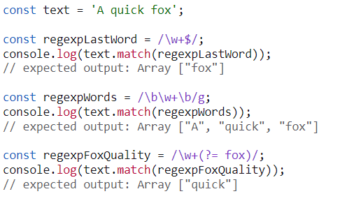
Assertions:
Assertions include boundaries, which indicate the beginnings and endings of lines and words, and other patterns indicating in some way that a match is possible (including look-ahead, look-behind, and conditional expressions).

Slide 8
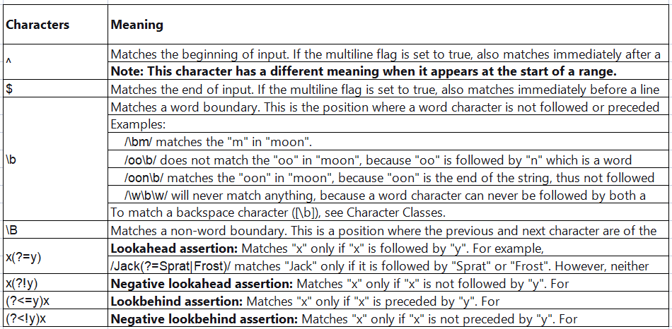
Assertions

Slide 9
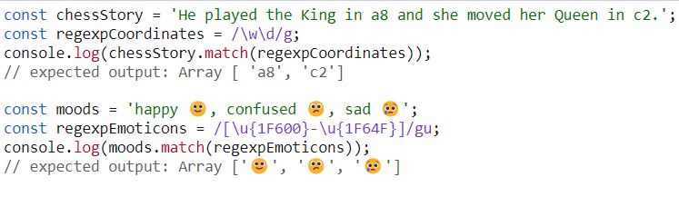
Character classes
Distinguish different types of characters. For example, distinguishing
between letters and digits.

Slide 10
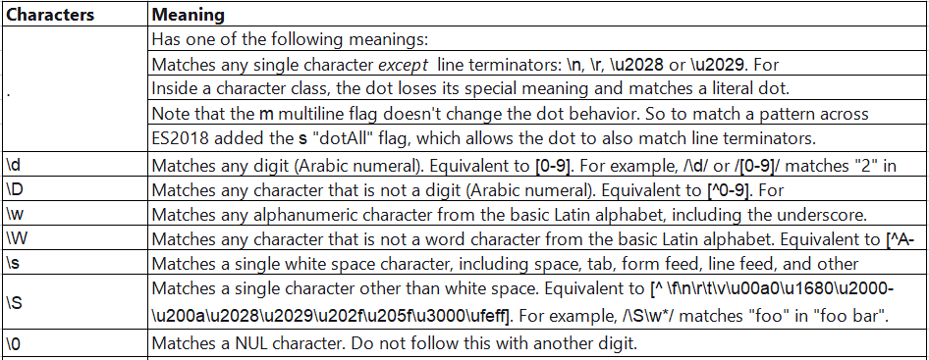
Character classes

Slide 11
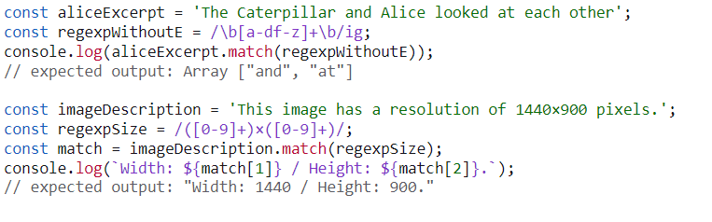
Groups and ranges
Groups and ranges indicate groups and ranges of expression characters.

Slide 12
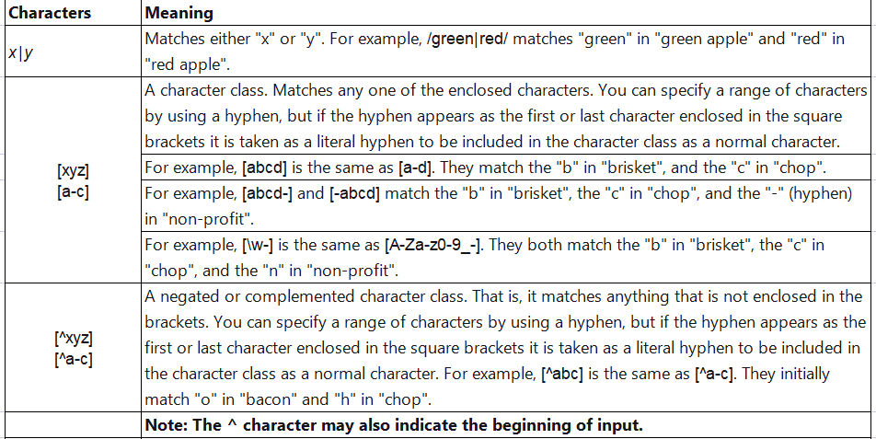
Groups and ranges

Slide 13
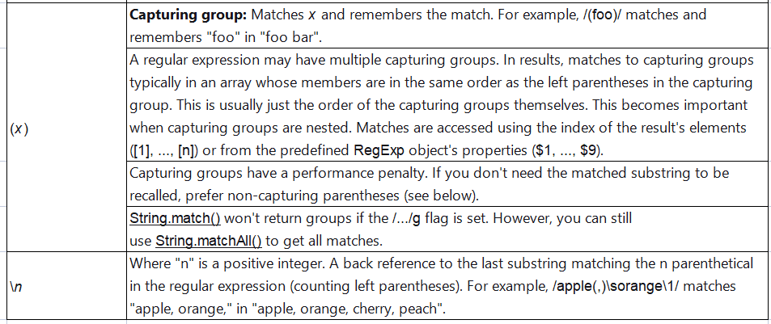
Groups and ranges

Slide 14
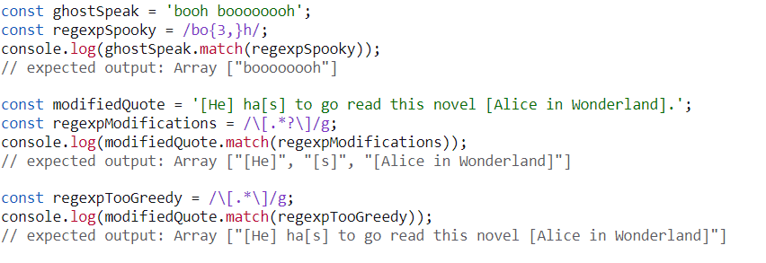
Quantifiers
Quantifiers indicate numbers of characters or expressions to match.

Slide 15
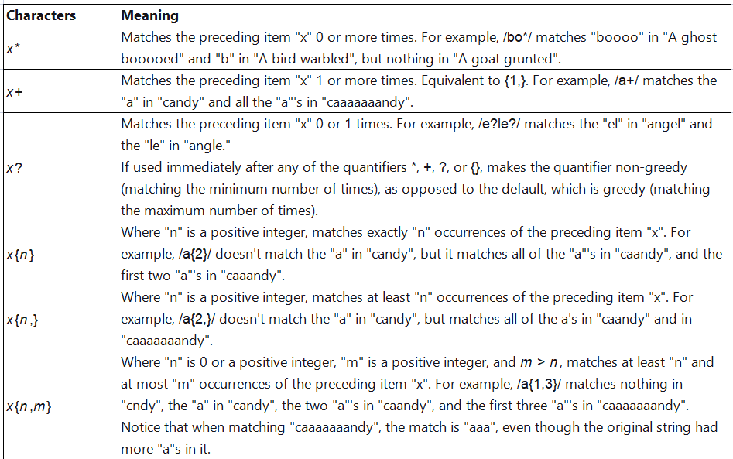
Quantifiers

Slide 16
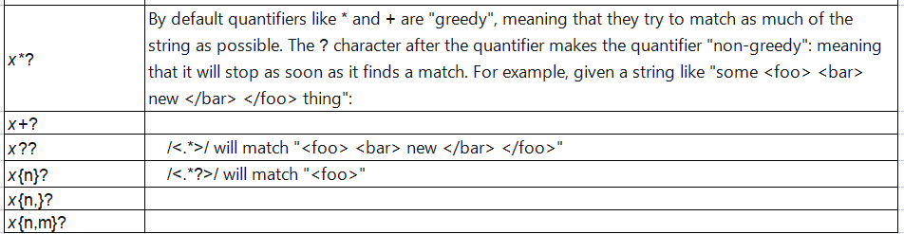
Quantifiers

Slide 17
Examples (Counting vowels)
var aliceExcerpt = "There was a long silence after this, and Alice could only hear whispers now and then.";
var regexpVowels = /[AEIOUYaeiouy]/g;
document.write ("Number of vowels:", aliceExcerpt.match(regexpVowels).length);
// Number of vowels: 26

Slide 18
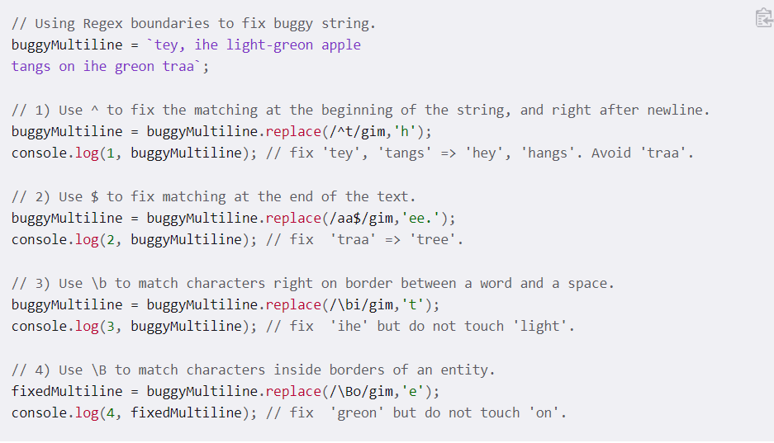
Examples (general boundary type)

Slide 19
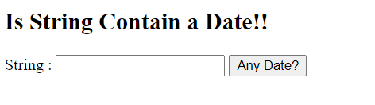
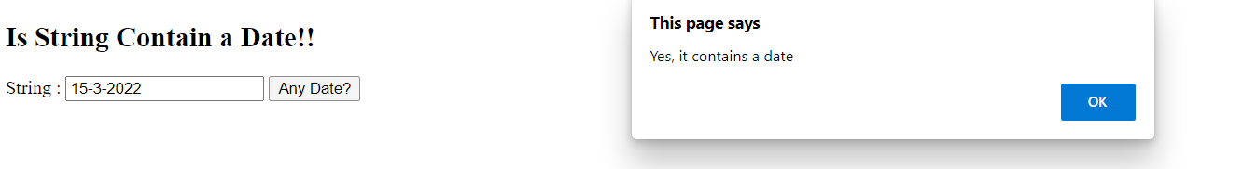
Exercise
Consider the snip below create the HTML view and appy regular expression
to validate the date format.
Date format required is

